Slide 1
Expression Databases
Manpreet S. Katari

Slide 2
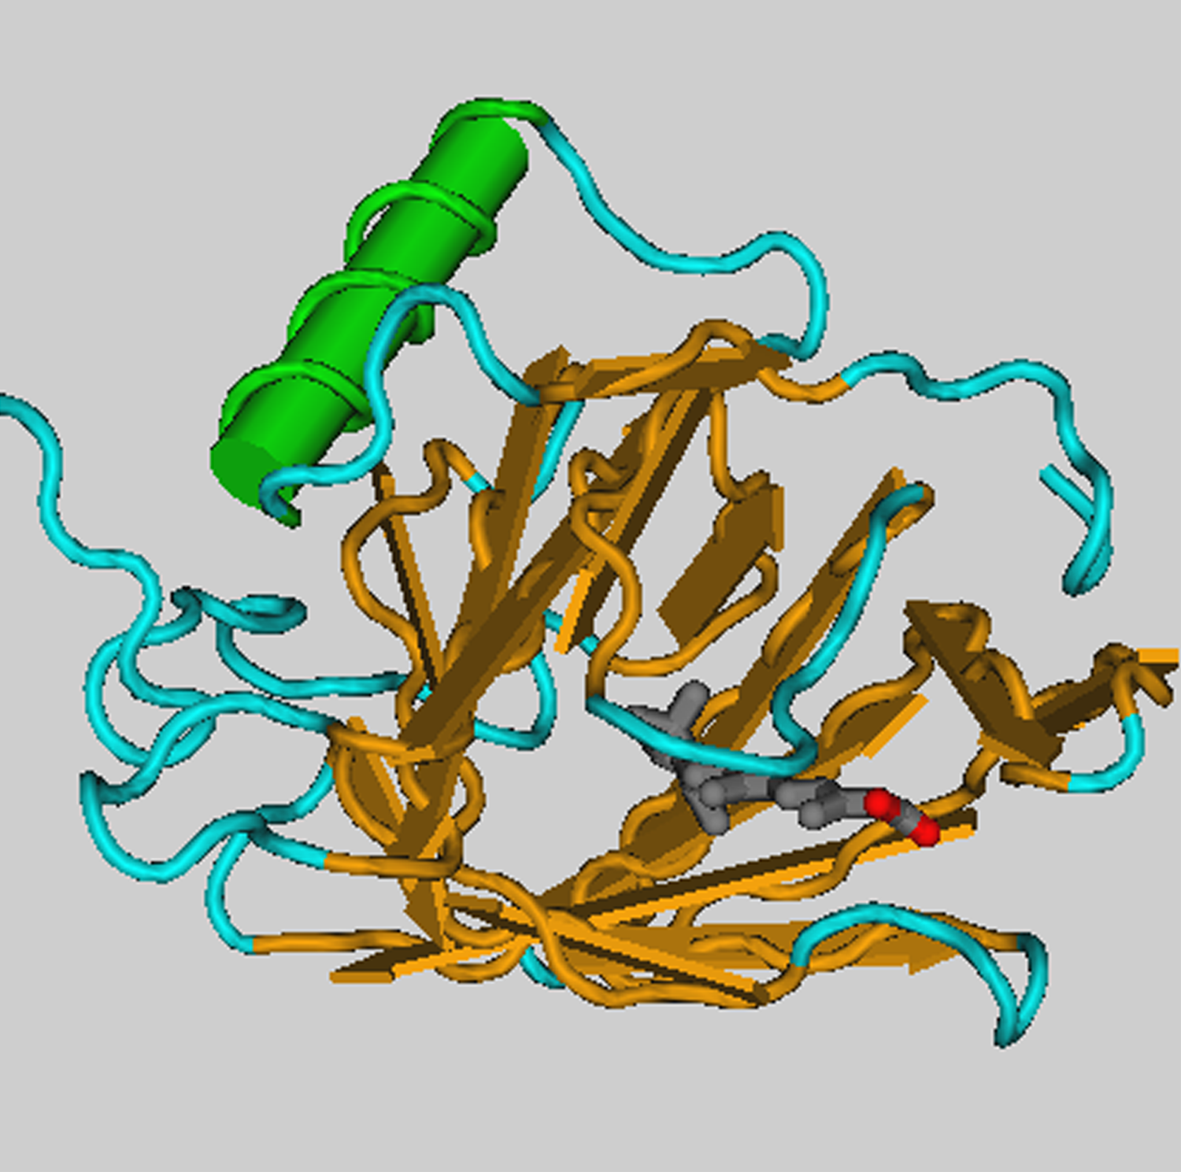
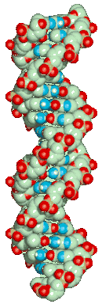
DNA
RNA
protein
phenotype
cDNA
Abundance of mRNA is what we try to measure

Slide 3
Questions that can be addressed with genome-wide expression analysis:
What genes have similar function?
What regulatory pathways exist?
Can we subdivide experiments or genes into meaningful classes?
Can we correctly classify an unknown experiment or gene into a known class?
Can we make better treatment decisions for a cancer patient based on his or her gene expression profile?

Slide 4
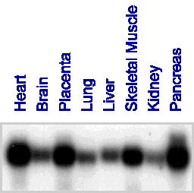
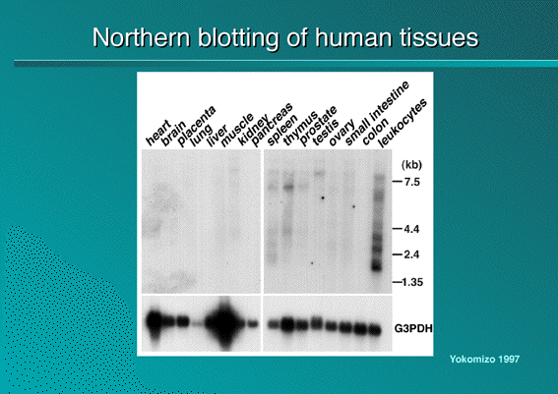
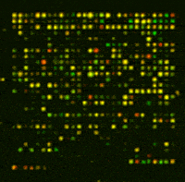
Microarrays vs Northern blots: from Gene to Genome Science
Northern blot: limited by number of lanes in gel
Microarray: A large number of DNA fragments are attached in a systematic way to a solid substrate, can measure mRNA levels for thousands of genes (~ every gene in a genome) in parallel
Notes:
Microarrays permit the simultaneous analysis of the RNA expression of thousands of genes. For fully sequenced genomes, microarrays can be used to analyze the expression of every gene. Northern blots, on the other hand, are limited by the number of lanes on the gel and by the number of probes that can be used on the same blot. Northern blots normally have 20–40 lanes, and no more than three probes can be used simultaneously. Thus, microarrays increase the throughput by several orders of magnitude.
DNA Microarrays are an extremely powerful tool. Whereas we have traditionally examines genes in isolation, DNA microarrays allow us to see all the genes of an cell working together in concert.
DNA Microarrays allow us to see the gene expression levels for tens of thousands of genes at once.
A microarray of 50,000 unique cDNAs allows the expression monitoring of the entire human genome in a single hybridization.

Slide 5
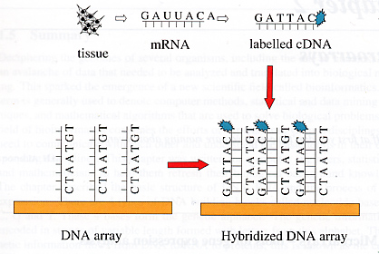
What is a microarray?

Slide 6
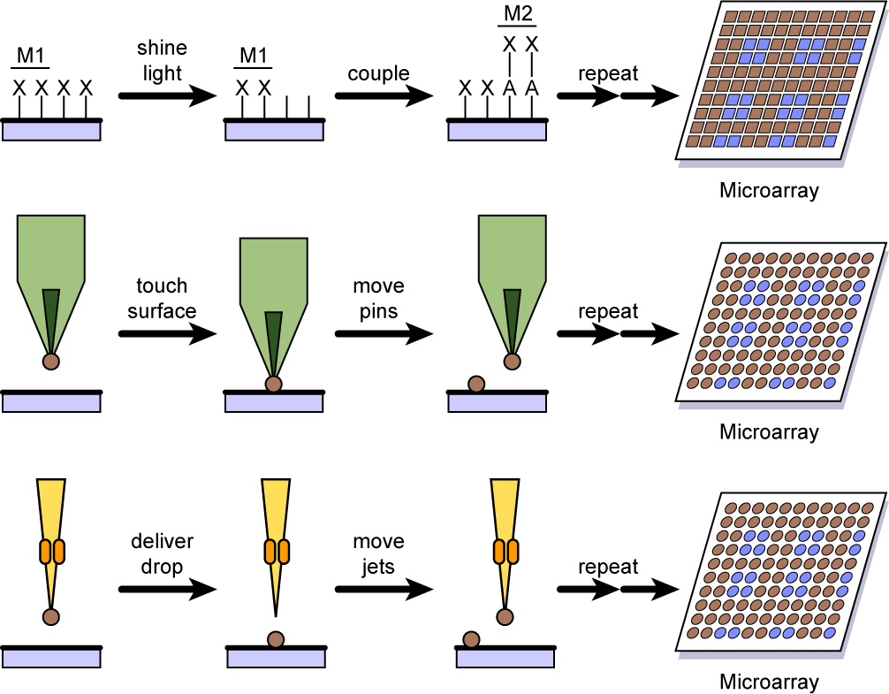
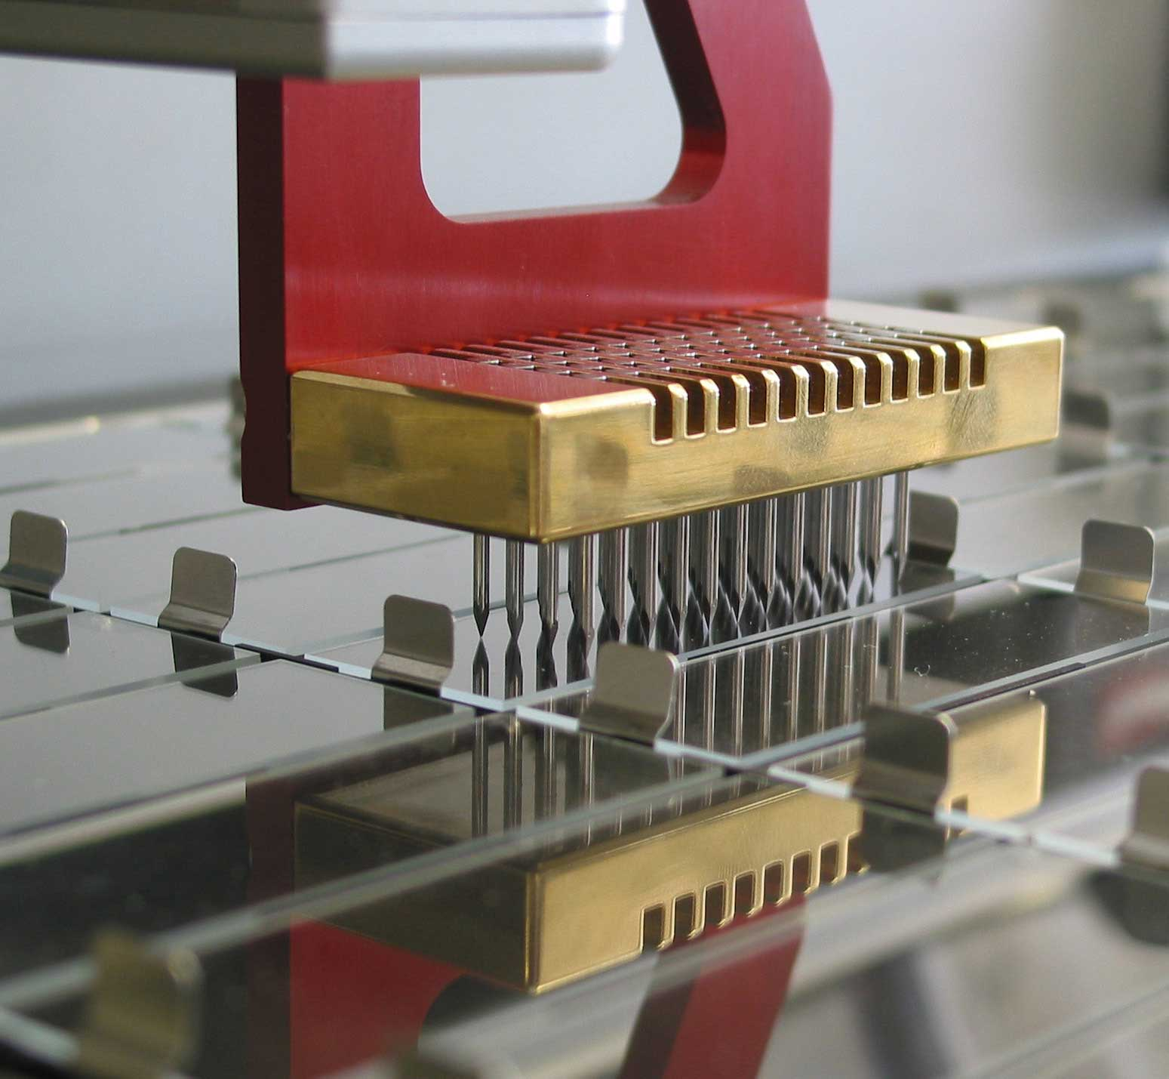
Spotted microarrays: how they are made
DNA mechanically placed on glass slide
Need to deliver nanoliter to picoliter volumes (too small for normal pipetting devices)
Robot “prints,” or “spots,” DNA in specific places
DNA spotting usually uses multiple pins
DNA in microtiter plate
DNA usually PCR amplified
Notes:
Different technologies are being used for the production of microarrays. The most commonly used microarray technologies are mechanical spotting and photolithography. Mechanical spotting involves placing very small quantities of DNA on glass slides. The volumes of liquid in which the DNA is suspended are in the nanoliter to picoliter range, which is too small for normal pipetting devices. Robots have been adapted to handle these small volumes and to “spot” or “print” them at precisely determined locations on glass slides.
Most robotic spotters use pins that act by capillary action similar to that of fountain pens. Multiple pins are mounted together and dipped simultaneously into DNA aliquoted into the different wells of a microtiter plate. The DNA in the wells has usually been amplified from cDNA or genomic DNA, using PCR. Oligonucleotides can also be spotted in this way.

Slide 7
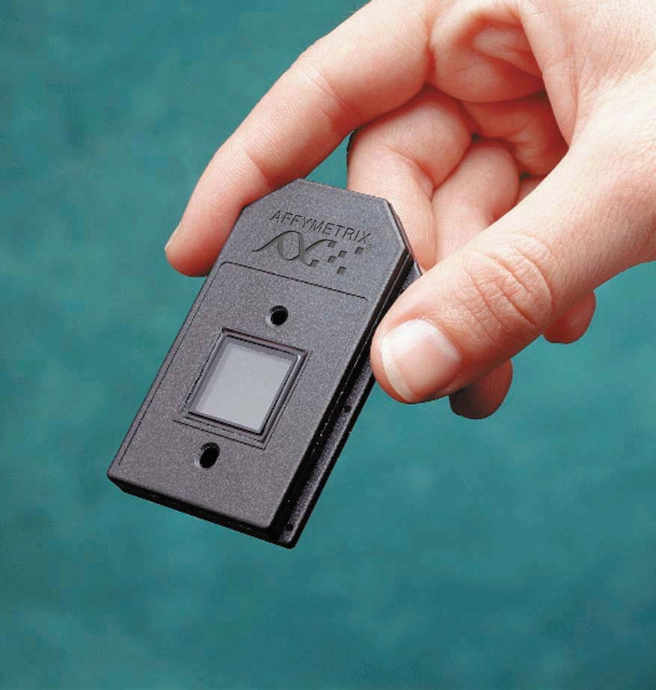
Affymetrix gene chip

Slide 8
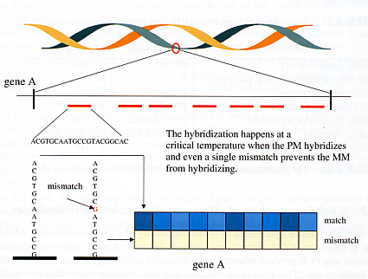
Affymetrix Array

Slide 9
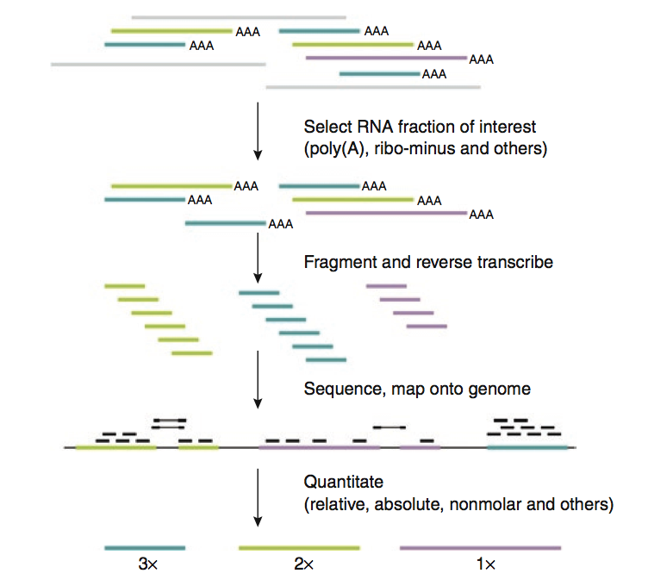
Transcriptomics using RNA-seq
Notes:
Figure 5 | Overview of RNA-seq. A RNA fraction of interest is selected, fragmented and reverse transcribed. The resulting cDNA can then be
sequenced using any of the current ultra-high-throughput technologies to obtain ten to a hundred million reads, which are then mapped back onto the
genome. The reads are then analyzed to calculate expression levels.

Slide 10
Gene expression can be assayed across many different conditions
Experiment 1
Experiment 2
Experiment 3
Experiment 4
Experiment 5
Experiment 6
Experiment 7
Experiment 8
Experiment 9
Experiment 10
Gene 1
> 8.0
Gene 2
> 4.8
> 2.8
Gene 3
> 1.7
Gene 4
1:1
Gene 5
> 1.7
…
…
> 2.8
> 4.8
Gene 10,000
> 8.0
A separate microarray experiment is performed using mRNA isolated from each different “condition”, e.g.:
Developmental time course
Time course after exposure to some environmental stimulus (chemical, light/dark, etc.)
Different tissues
Normal vs. diseased tissue

Slide 11
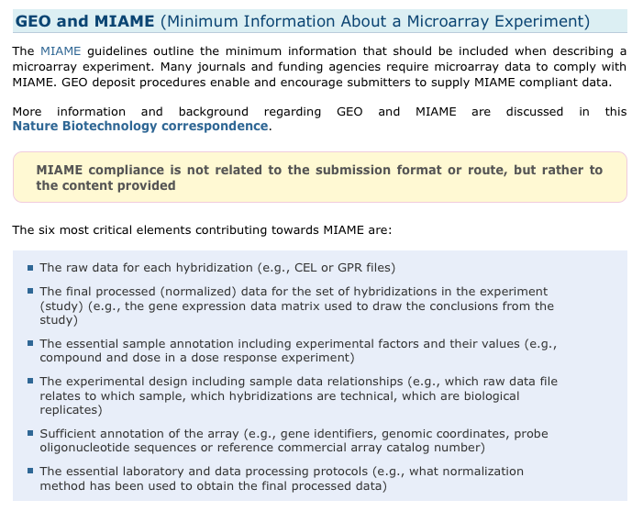
Standard Format (MIAME)
http://www.ncbi.nlm.nih.gov/geo/info/MIAME.html

Slide 12
Common Databases
Microarray Data
NCBI GEO (Gene Expression Omnibus)
ArrayExpress
RNA-seq
NCBI SRA (Sequence Read Archive)
ENA (European Nucleotide Archive)

Slide 13
Gene Expression Omnibus Repository (GEO)
http://www.ncbi.nlm.nih.gov/geo/
Platform – information regarding the technology used (GPLXXXX)
Sample – information submitted by the experimenter regarding the conditions and manipulations (GSMXXXX)
Series – Samples are linked with series which defines the entire dataset (GSEXXX)
GEO Dataset – GEO sample information collected by GEO staff. Can be used to compare with other datasets.

Slide 14
GEOquery Package
>source(“http://bioconductor.org/biocLite.R”)
>biocLite(“GEOquery”)
>library(“GEOquery”)
>gds<-getGEO(“GDS2084”)
>Meta(gds)
>head(Table(gds))
>Columns(gds)
>gsm<-getGEO(“GSM114841”)
>Meta(gsm)
>Columns(gsm)
>head(Table(gsm)

Slide 15
Different Utilities for Deep-Seq
RNA-seq
Sequencing equivalent to Microarray data
Method for discovering new RNA molecules
Method for quantifying RNA abundance
CHIP-seq (Chromatin Immuno Precipitation)
Method for indentifying region of genome where a particular protein is binding.
Transcription Factors
Histone Modifications

Slide 16
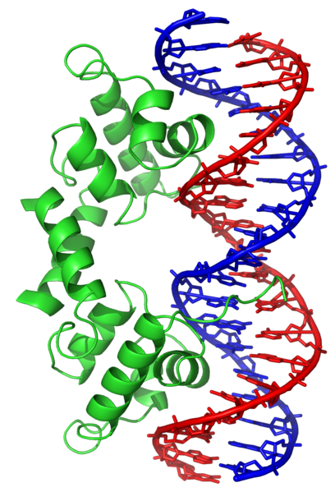
Transcription Factors
http://en.wikipedia.org/wiki/DNA_binding_protein

Slide 17
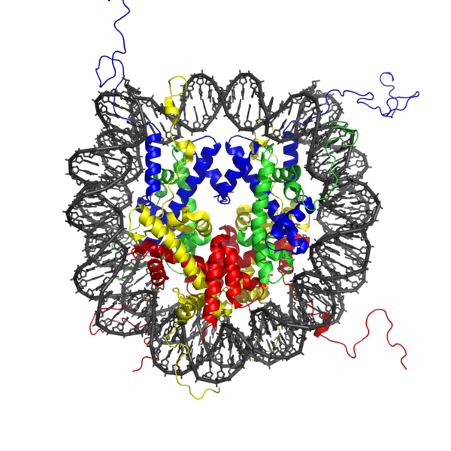
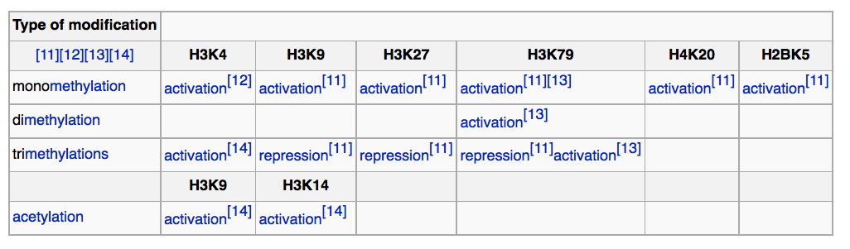
Histone Modification
http://en.wikipedia.org/wiki/Nucleosome

Slide 18
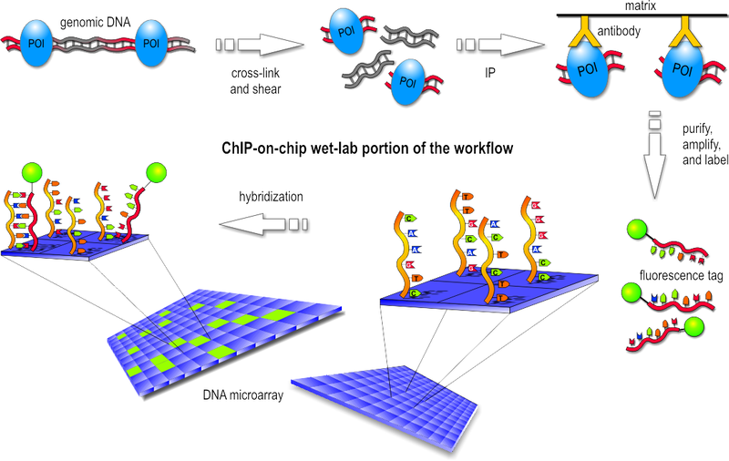
CHIP-chip
http://en.wikipedia.org/wiki/ChIP-on-chip

Slide 19
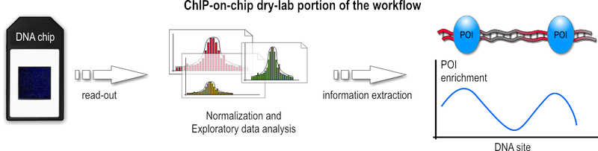
Regions of the genome that are enriched for sequences are areas where protein interacts

Slide 20
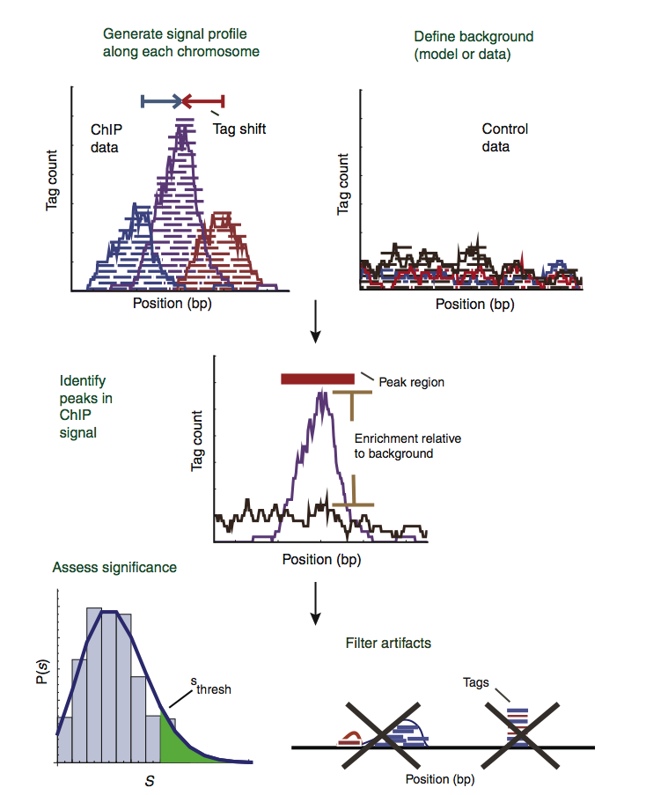
CHIP-seq: same idea but sequencing instead of hybridization.

Slide 21
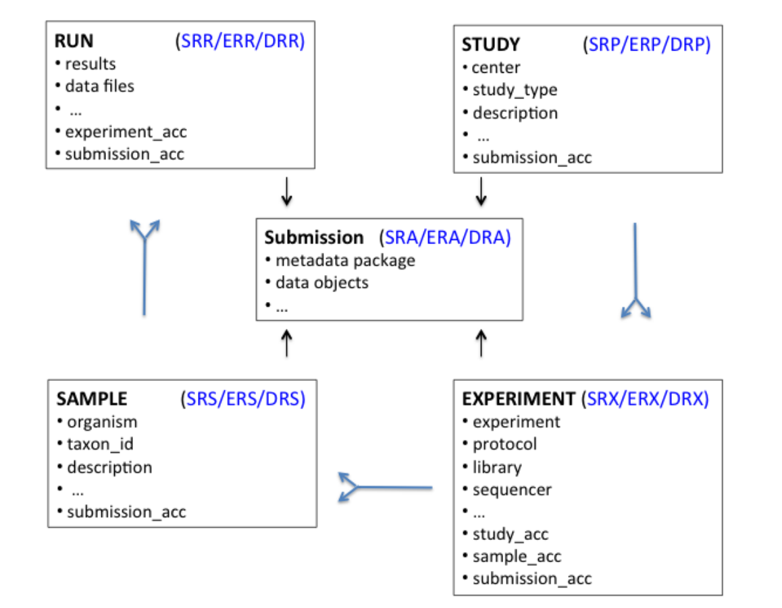
Connecting to the SRA database
SRA database : http://www.ncbi.nlm.nih.gov/sra

Slide 22
DNA
RNA
protein
phenotype
cDNA
Protein Interactions

Slide 23
Protein Structural Elements
2º Structural Elements
α-Helix
β-Sheet
Globular regions
Domains
SH2
Leucine Zipper

Slide 24
Domains
Discrete structural units
Can infer boundaries from sequence analysis
25 – 500 residues long
Most < 200 residues
Less than 50 residues usually stabilized by S–S bonds or metal ions

Slide 25
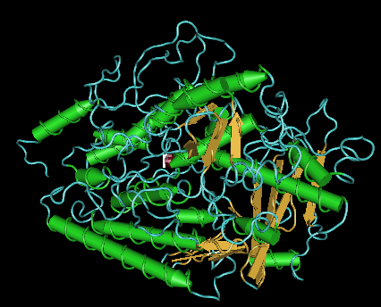
Lipoxygenase Domain
>500 residues
Notes:
are a family of iron-containing enzymes that catalyse the dioxygenation of polyunsaturated fatty acids in lipids containing a cis,cis-1,4- pentadiene structure. It catalyses the following reaction:
fatty acid + O₂ = fatty acid hydroperoxide

Slide 26
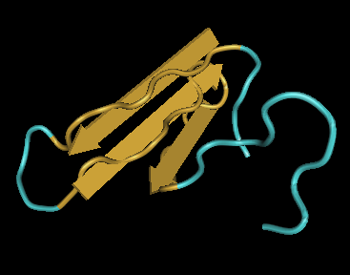
WW Domain
33 residues
Notes:
is a protein domain with two highly conserved tryptophans that binds proline-rich peptide motifs.

Slide 27
Domain Determination
Internal duplications
Detect with a dotplot
Transmembrane segments
Hydrophobic, 15–35 residues
Segments easy to predict
Topology and multiple segments harder to predict
PHD, TMHMM, TMpred
Low complexity segments
Composition typically “non-random”
Non-compact folds: coiled coils, rods, flexible domain linkers
Complexity function (SEG)
Small-pitch overlapping repeats (XNU)

Slide 28
Protein Sequence Databases
GenPept
Swiss-Prot
TrEMBL

Slide 29
Protein Domain Databases
Pfam
PROSITE
BLOCKS
PRINTS
CDD
ProDom
SMART
InterPro

Slide 30

HMM family profiles constructed by hand
Structural data in alignments
No hierarchy
No specific compositional bias
Good graphical output

Slide 31
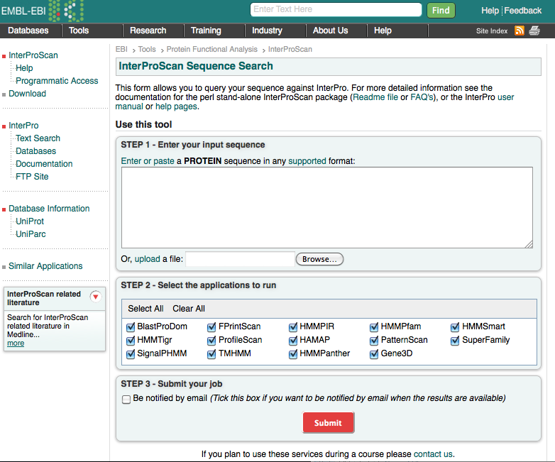
Interproscan
http://www.ebi.ac.uk/Tools/pfa/iprscan/

Slide 32
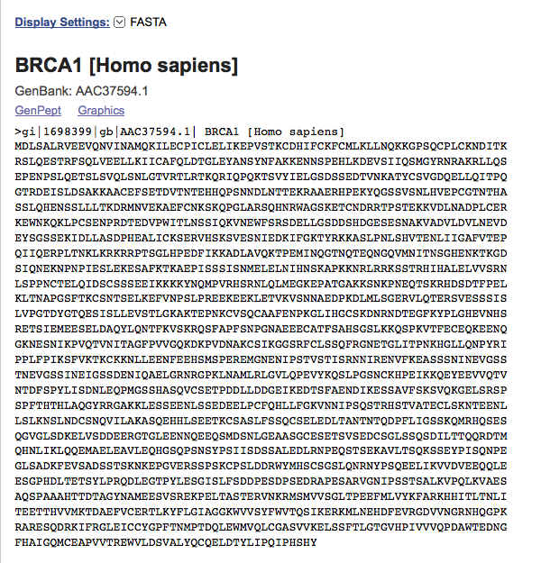
BRCA1 protein sequence from NCBI in FASTA format
http://www.ncbi.nlm.nih.gov/protein/1698399?report=fasta

Slide 33
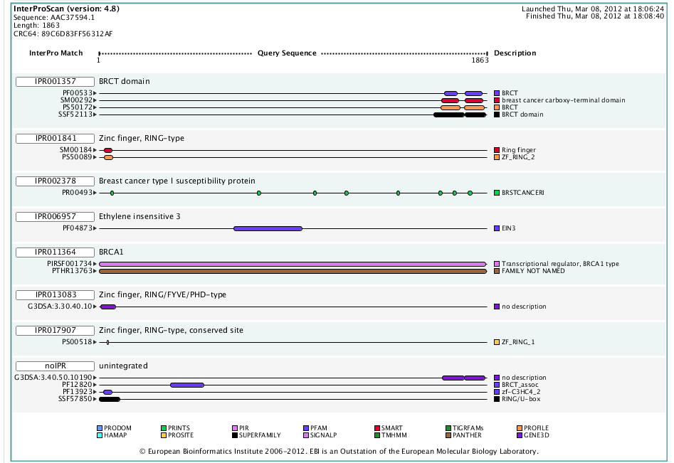
Interproscan results

Slide 34
Protein Interaction Databases
Generating Data
Protein chips
Y2H
Databases
String
BioGRID

Slide 35
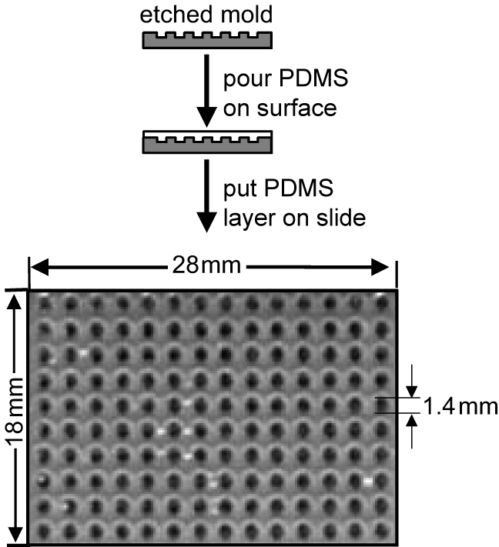
Fabricating protein chips
Protein substrates
Polyacrylamide or agarose gels
Glass
Nanowells
Proteins deposited on chip surface by robots
* polydimethoxylsiloxane
flexible silicon-based polymer (elastomer)
*
Notes:
The first challenge of fabricating a protein chip is to construct a physical array that can hold proteins, isolate them from each other, and prevent them from becoming denatured. This can be accomplished by depositing miniature pads of polyacrylamide or agarose gel on a glass surface, attaching proteins directly to glass slides, or constructing tiny wells called nanowells (shown in slide) that can hold nanoliters of solution containing a particular protein.
In the case of miniature gel pads, acrylamide is trapped between a glass slide and a quartz plate that has a mask drawn on it. The quartz plate is then exposed to ultraviolet light, which causes the acrylamide in regions not covered by the mask to polymerize. The glass slide is then rinsed with water, which washes away the unpolymerized acrylamide, leaving the researcher with a set of gel pads that can be as small as 25 X 25 X 20 microns. Proteins (or other molecules) can then be deposited directly onto the gel pads.
Attaching proteins to glass directly can be accomplished by treating a glass surface with a reagent that covalently attaches to proteins.
The protein-chip substrates described here should be considered only a sampling, as new techniques are constantly being developed. For all the methods described thus far, proteins are deposited using traditional technology or by robots similar to those used in the manufacture of nucleic acid microarrays. The next slide focuses on strategies for attaching proteins (or other molecules) to the chip’s surface.

Slide 36
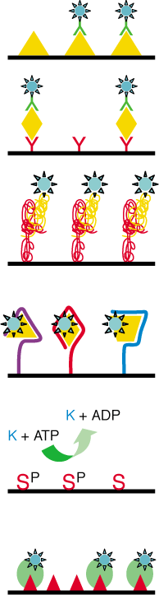
Classes of capture molecules
Different capture molecules must be used to study different interactions
Examples
Antibodies (or antigens) for detection
Proteins for protein-protein interaction
Enzyme-substrate for biochemical function
Antigen–
antibody
Protein–
protein
Aptamers
Enzyme–
substrate
Receptor–
ligand
Notes:
The term “capture molecule” refers to the agent that interacts with molecules applied to the chip to carry out some kind of assay. Several different types of capture molecules have been used to study proteins. The resulting arrays can be divided into two broad categories: analytical microarrays and functional protein chips.
Analytical microarrays use attached antibodies or antigens to detect specific proteins in complex mixtures that are applied to the chip. Conversely, functional protein chips use vast arrays of different proteins to probe protein function. For example, protein–protein interactions can be studied by applying specific proteins to protein chips. Biochemical function can be probed by adding substrates to a protein chip. Protein lipid interactions can be examined by adding lipids in the form of liposomes to protein chips, and from a practical standpoint, putative drugs can be added to protein chips to determine a drug target. Similarly, a ligand chip can be constructed and proteins can be applied to it. Beyond the world of proteins, researchers have been able to successfully demonstrate a working carbohydrate chip.

Slide 37
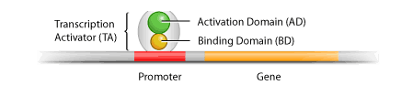
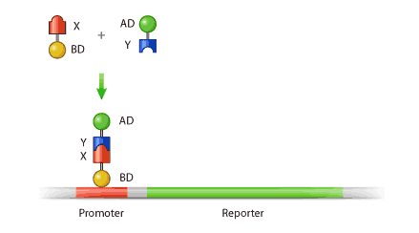
The yeast two-hybrid system (Y2H)
A two-domain transcriptional activator
“Bait” gene X fused to BD
“Prey” gene Y fused to AD
“Prey” gene Y fused to AD
When Bait & Prey Bind
Prey
Activation of Reporter Gene
(b-Gal or HIS)
Bait
If X and y physically interact, BD and AD are brought together and can activate transcription of a “reporter” gene (such as -galactosidase or an auxotrophic selection marker (e.g. HIS))

Slide 38
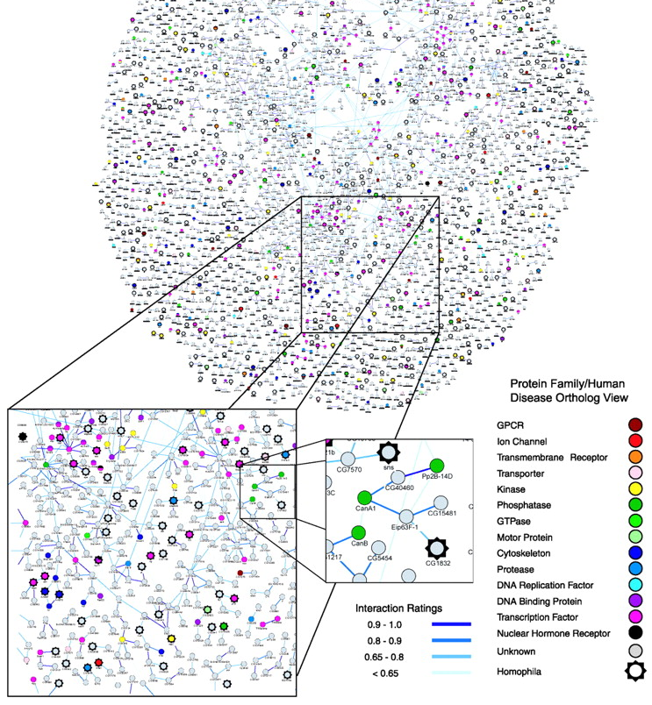
Drosophila interaction map
Notes:
Recently a group of researchers from CuraGen Corporation, a biotechnology company, completed an extensive protein-interaction map of Drosophila, using the yeast two-hybrid system. The image in this slide shows the entire interaction map as well as close-up of a particular region. The nodes of the interaction map are coded to indicate the likely function of the protein they represent. Black stars around a node indicate a gene implicated in human disease. For this map, the 3,000 interactions with the highest confidence values were chosen, and they link 3,522 proteins.

Slide 39
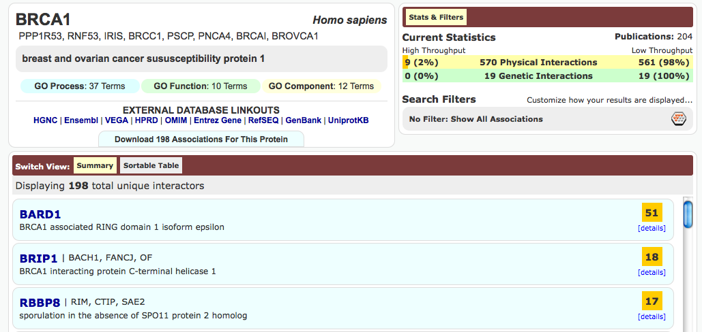
BIOGRID: searching for BRCA1 interactions
http://thebiogrid.org

Slide 40
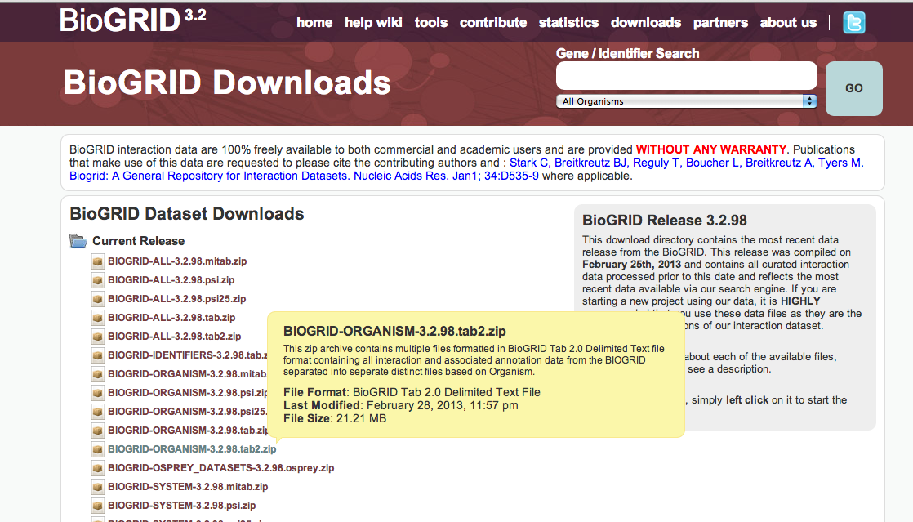
Download interactions

Slide 41
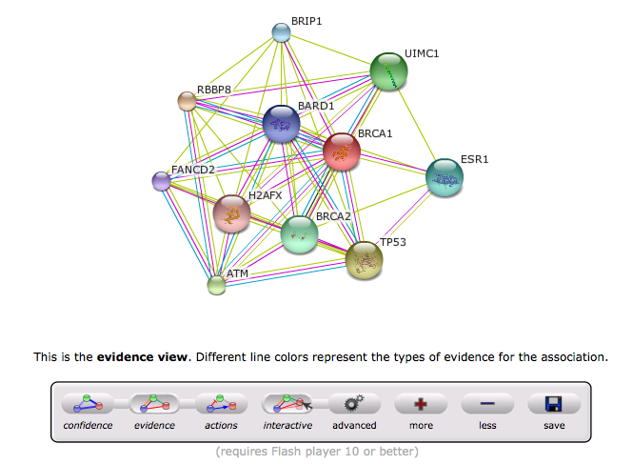
String: searching for BRCA1 interactions
http://string-db.org/

